Slide 1

Computer Organization and Architecture
Central Processing Unit (CPU)

Slide 2
TOPIC TO BE COVERED:
Central Processing Unit (CPU)
General Register Organization
Stack Organization
Instruction Format
Addressing Modes

Slide 3
Central Processing Unit (CPU)
CPU is the brain of the computer. All types of data processing operations and all the important functions of a computer are performed by the CPU.
The CPU consists of 3 major units, which are:
Memory or Storage Unit
Control Unit
ALU(Arithmetic Logic Unit)

Slide 4
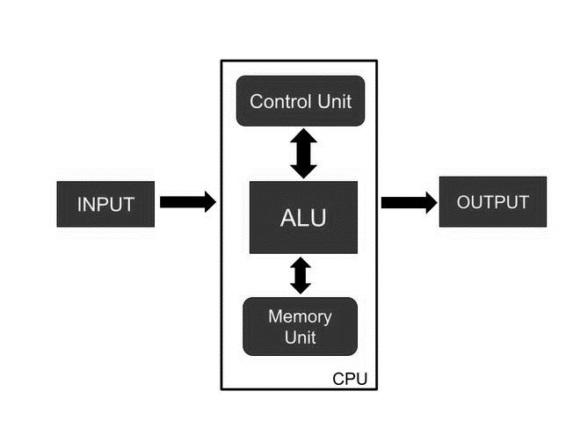
Central Processing Unit (Cont..)

Slide 5
Central Processing Unit (Cont..)
Memory or Storage Unit:
Data and instructions are stored in memory units which are required for processing.
It also stores the intermediate results of any calculation or task when they are in process.
The final results of processing are stored in the memory units before these results are released to an output device for giving the output to the user.
All sorts of inputs and outputs are transmitted through the memory unit.

Slide 6
Central Processing Unit (Cont..)
Control Unit:
Controlling of data and transfer of data and instructions is done by the control unit among other parts of the computer.
The control unit is responsible for managing all the units of the computer.
The main task of the control unit is to obtain the instructions or data which is input from the memory unit, interprets them, and then directs the operation of the computer according to that.
The control unit is responsible for communication with Input and output devices for the transfer of data or results from memory.
The control unit is not responsible for the processing of data or storing data.

Slide 7
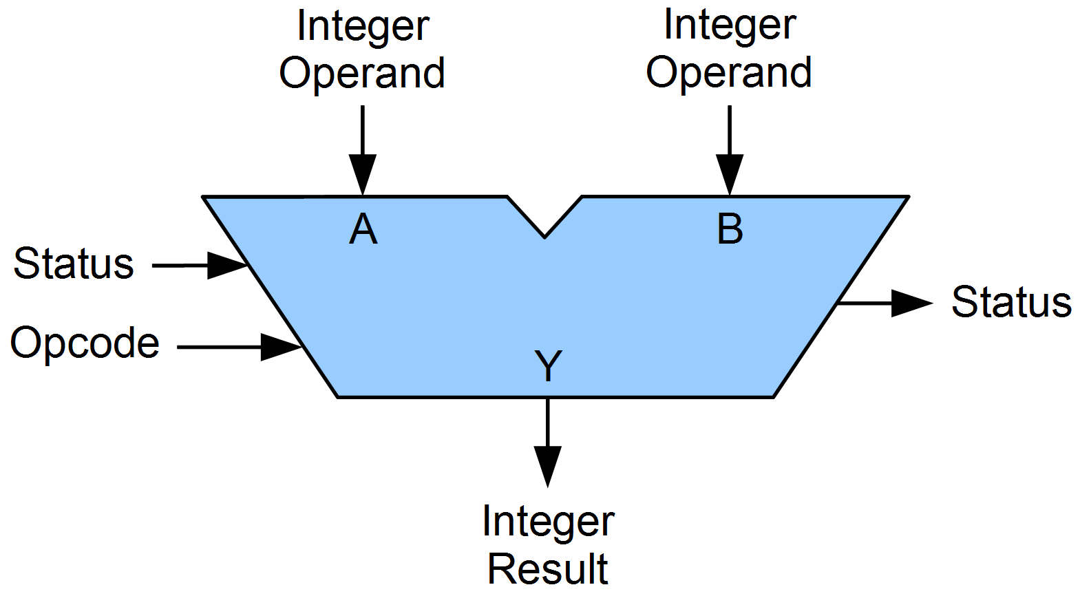
Central Processing Unit (Cont..)
ALU (Arithmetic Logic Unit) :
Arithmetic Section
Logic Section

Slide 8
General Register Organization
A set of flip-flops forms a register. A register is a unique high-speed storage area in the CPU.
Registers implement two important functions in the CPU operation are as follows −
It can support a temporary storage location for data. This supports the directly implementing programs to have fast access to the data if required.
It can save the status of the CPU and data about the directly implementing program.

Slide 9
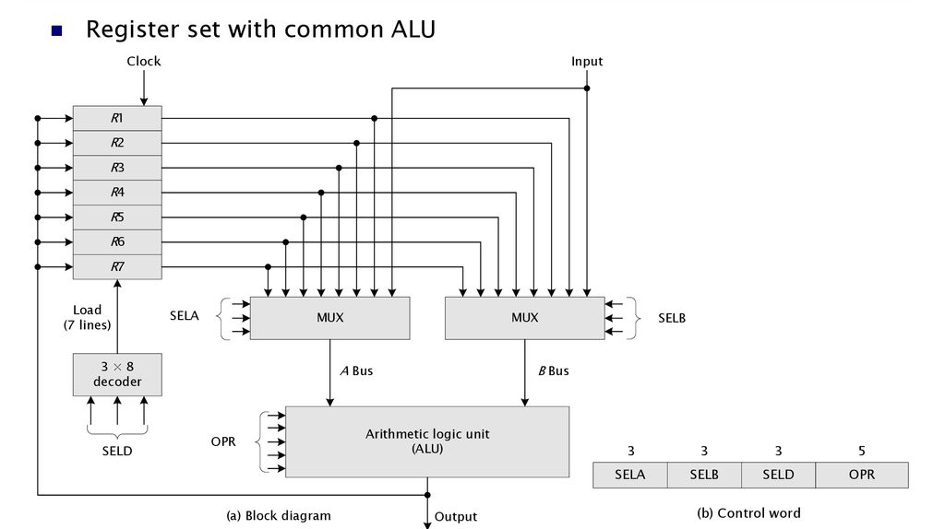
General Register Organization (Cont..)

Slide 10
General Register Organization (Cont..)
The CPU bus system is managed by the control unit. The control unit explicit the data flow through the ALU by choosing the function of the ALU and components of the system.
Consider R1 ← R2 + R3, the following are the functions implemented within the CPU −
MUX A Selector (SELA) − It can place R2 into bus A.
MUX B Selector (SELB) − It can place R3 into bus B.
ALU Operation Selector (OPR) − It can select the arithmetic addition (ADD).
Decoder Destination Selector (SELD) − It can transfers the result into R1.
The multiplexers of 3-state gates are performed with the buses. The state of 14 binary selection inputs determines the control word. The 14-bit control word defines a micro-operation.

Slide 11
General Register Organization (Cont..)
The encoding of register selection fields is specified in the table.
Encoding of Register Selection Field
Binary Code | SELA | SELB | SELD
000 | Input | Input | None
001 | R1 | R1 | R1
010 | R2 | R2 | R2
011 | R3 | R3 | R3
100 | R4 | R4 | R4
101 | R5 | R5 | R5
110 | R6 | R6 | R6
111 | R7 | R7 | R7

Slide 12
Stack Organization
What is Stack:
The stack is a storage device, used for storing information or data in a manner of LIFO (Last In First Out). Whenever we enter the data in the form of LIFO manner, the element that has to be deleted first is the last inserter element, so the last inserted element is taken out first. It is the memory unit within an address register called stack pointer (SP). The stack pointer always indicates the top element in the stack that means which location the data has to be inserted.
Type of Stack:
Register Stack
Memory Stack

Slide 13
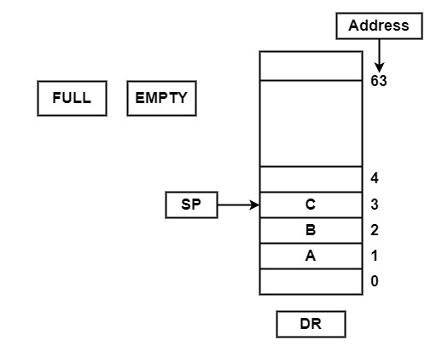
Stack Organization (Cont..)
Register Stack

Slide 14
Stack Organization (Cont..)
Register Stack
The push operation is executed as follows −
SP←SP + 1 | It can increment stack pointer
K[SP] ← DR | It can write element on top of the stack
If (SP = 0) then (FULL ← 1) | Check if stack is full
EMTY ← 0 | Mark the stack not empty

Slide 15
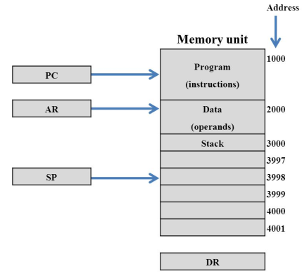
Stack Organization (Cont..)
Memory Stack
Step1: SP←SP+1
Step2: M[SP]←DR
Pop operation in Memory Stack
Step1: DR←M[SP]
Step2: SP←SP-1

Slide 16
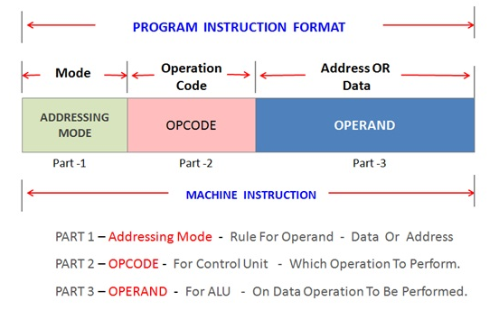
Instruction Format
Based on the number of address, instructions are classified as:
Zero address instructions
One address instructions
Two address instructions
Three address instructions

Slide 17
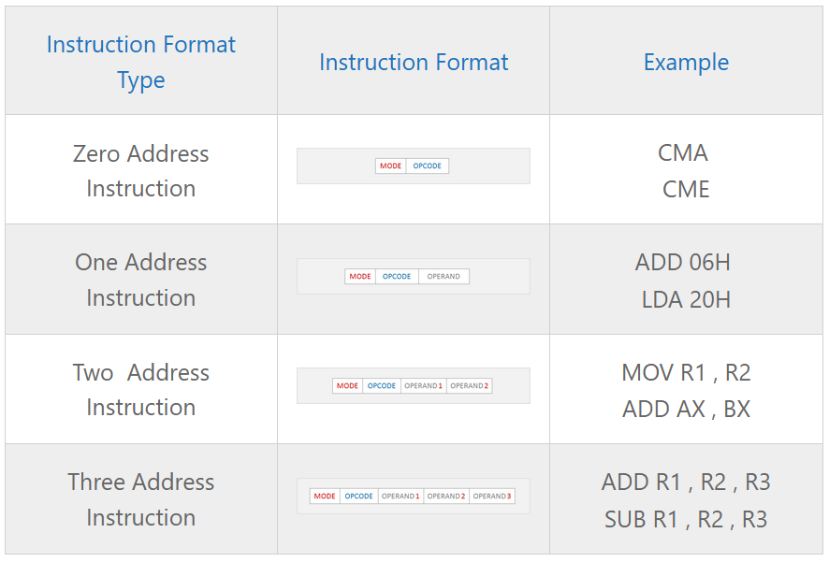
Instruction Format (Cont..)

Slide 18
Instruction Format (Cont..)
Zero address instruction
Expression: X = (A+B)*(C+D)
Postfixed : X = AB+CD+*
TOP means top of stack
M[X] is any memory location
PUSH | A | TOP = A
PUSH | B | TOP = B
ADD |  | TOP = A+B
PUSH | C | TOP = C
PUSH | D | TOP = D
ADD |  | TOP = C+D
MUL |  | TOP = (C+D)*(A+B)
POP | X | M[X] = TOP

Slide 19
Instruction Format (Cont..)
One address instruction
Expression: X = (A+B)*(C+D)
AC is accumulator
M[] is any memory location
M[T] is temporary location
LOAD | A | AC = M[A]
ADD | B | AC = AC + M[B]
STORE | T | M[T] = AC
LOAD | C | AC = M[C]
ADD | D | AC = AC + M[D]
MUL | T | AC = AC * M[T]
STORE | X | M[X] = AC

Slide 20
Instruction Format (Cont..)
Two address instruction
Expression: X = (A+B)*(C+D)
R1, R2 are registers
M[] is any memory location
MOV | R1, A | R1 = M[A]
ADD | R1, B | R1 = R1 + M[B]
MOV | R2, C | R2 = C
ADD | R2, D | R2 = R2 + D
MUL | R1, R2 | R1 = R1 * R2
MOV | X, R1 | M[X] = R1

Slide 21
Instruction Format (Cont..)
Three address instruction
Expression: X = (A+B)*(C+D)
R1, R2 are registers
M[] is any memory location
ADD | R1, A, B | R1 = M[A] + M[B]
ADD | R2, C, D | R2 = M[C] + M[D]
MUL | X, R1, R2 | M[X] = R1 * R2

Slide 22
Addressing Modes
Addressing Modes– The term addressing modes refers to the way in which the operand of an instruction is specified. The addressing mode specifies a rule for interpreting or modifying the address field of the instruction before the operand is actually executed.
The various kind of addressing modes:
Implied Mode
Immediate Mode
Register Mode
Register Indirect Mode
Autodecrement Mode
Autoincrement Mode
Direct Address Mode
Indirect Address Mode
Indexed Addressing Mode

Slide 23
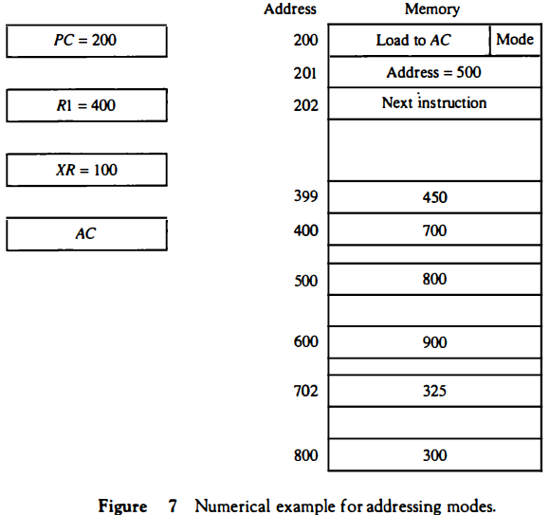
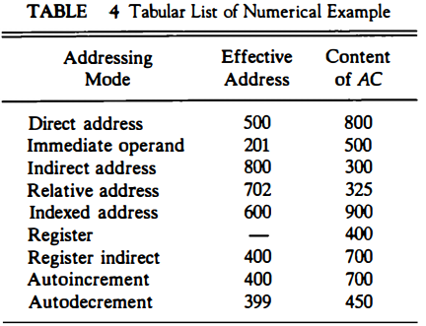
Addressing Modes (Cont..)
Numerical Example for addressing Mode

Slide 24
Thank You

